Slide 1
Data Mining Project- Seminar 3
Understanding & Predicting the Stress Level of Nurses During Covid19 using Sensors Data
Tanvir Hasan
Qiqi Xie
Shafin Alam
Seam Zaman
Supervisor: Pekka Siirtola

Slide 2
Results
RQ 1: How do physiological variables, such as electrodermal activity, heart rate, and skin temperature, correlate with reported stress levels among nurses?
No
Spearman Correlation
Normality check
Calculated corr. score and corresponding P-value
Data
scatter plot with regression line
Yes
Pearson Correlation
Flow diagram of correlation analysis to explore RQ 1

Slide 3
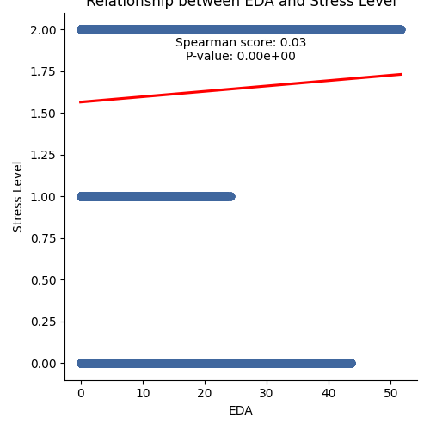
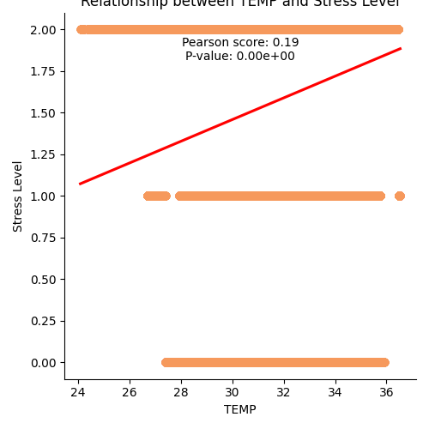
RQ 1: How do physiological variables, such as electrodermal activity, heart rate, and skin temperature, correlate with reported stress levels among nurses?
Skin Temperature has a somewhat higher link with stress than EDA does

Slide 4
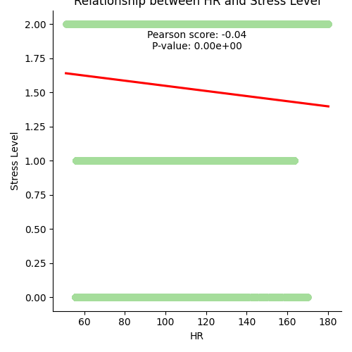
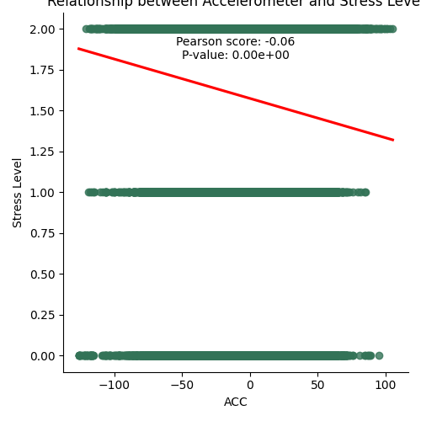
RQ 1: How do physiological variables, such as electrodermal activity, heart rate, and skin temperature, correlate with reported stress levels among nurses?
These findings imply that stress levels among nurses and both HR and ACC measurements may have a little negative correlation. It's important to remember that the connections are somewhat weak, suggesting that in this particular situation, HR and physical activity as determined by ACC may not be very reliable indicators of stress levels.

Slide 5
Model training
RQ2. Can machine learning models accurately predict stress levels based on
Leave One Group Out Cross Validation Technique
Features
One participants data for test
End of LOGO cross validation
Evaluation
Prepare features and target variable
For each fold in cross-validation:
Model training
Mean Evaluation Metrics
Apply SMOTE to balance class imbalance
Remaining participants data for train
Feature scaling
Flow diagram of ML model

Slide 6
Performance of different ML Models on Raw data using Leave One Group Out Cross Validation
Algorithms | Mean Accuracy | Mean Precision | Mean Recall | Mean F1-score
DT | 0.513 | 0.785 | 0.513 | 0.592
NN | 0.491 | 0.769 | 0.491 | 0.580
KNN | 0.569 | 0.768 | 0.569 | 0.629
XGBoost | 0.405 | 0.753 | 0.405 | 0.481
Figure 1. performance of our models using raw data

Slide 7
Data transformation
splitting the time series into distinct interval
Time window: 5s (160 rows)
Tools: spark
Raw data
Features: id, X, Y, Z, EDA, TEMP, HR (7)
Target: label (0,1,2)
Size: 11509050 (105606 duplicated rows)
Processed data
Features: id, X_min, X_max, X_median, X_avg, Y_min, Y_max, Y_median, Y_avg, Z_min, Z_max, Z_median, Z_avg, EDA_min, EDA_max, EDA_median, EDA_avg, TEMP_min, TEMP_max, TEMP_median, TEMP_avg, HR_min, HR_max, HR_median, HR_avg (25)
Taget: label (0,1,2)
Size: 71463

Slide 8
Modeling (XGBoost) & cross validation (Leave-one-out)
The model struggles to identify instances of minority classes (class 0,1)
Macro average which treats each class equally leads to a lower value than weighted average
The weighted average reflects the overall performance of the model while considering the uneven distribution of classes in the dataset
Nurse id=15 | Precision (raw/processed) |  | Recall (raw/processed) |  | F1-score (raw/processed) |  | Support (raw/processed)
0 | 0 | 0 | 0 | 0 | 0 | 0 | 13441 | 85
1 | 0 | 0 | 0 | 0 | 0 | 0 | 0 | 0
2 | 0.96 | 0.96 | 0.99 | 0.98 | 0.97 | 0.97 | 295690 | 1858
accuracy |  |  |  |  | 0.94 | 0.93 | 309131 | 1943
Macro avg | 0.32 | 0.48 | 0.33 | 0.49 | 0.32 | 0.48 | 309131 | 1943
Weighted avg | 0.91 | 0.91 | 0.94 | 0.93 | 0.93 | 0.92 | 309131 | 1943

Slide 9
Evaluating & comparison
If the minority class (class=0,1) are not well predicted by the model, it can contribute a low accuracy
the model is better at avoiding false positives on processed data
Nurse id=94 | Precision (raw/processed) |  | Recall (raw/processed) |  | F1-score (raw/processed) |  | Support (raw/processed)
0 | 0.21 | 0.57 | 0.01 | 0.01 | 0.01 | 0.02 | 366152 | 2292
1 | 0.86 | 0.91 | 0.38 | 0.37 | 0.52 | 0.53 | 87458 | 549
2 | 0.24 | 0.24 | 0.98 | 0.99 | 0.39 | 0.39 | 132485 | 833
accuracy |  |  |  |  | 0.28 | 0.28 | 586095 | 3678
Macro avg | 0.44 | 0.58 | 0.45 | 0.46 | 0.31 | 0.31 | 586095 | 3678
Weighted avg | 0.31 | 0.55 | 0.28 | 0.28 | 0.17 | 0.18 | 586095 | 3678

Slide 10
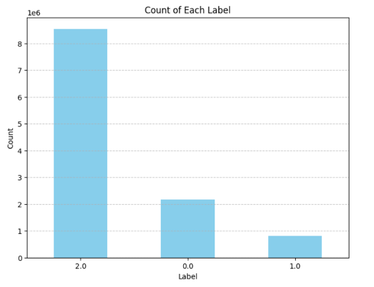
Fine-tuning model
Oversampling
Merged the minority classes into a single class and adjusted the labels accordingly (label: low, high)
Adjusting hyperparameters of the model

Slide 11
Key Findings: 1. The model can identify the high level of stress well 2. Oversampling puts more weight on the small class, which may lead to an overall accuracy decrease 3. Accuracy may be good enough for well-balanced dataset, but not ideal for imbalanced dataset.
 | Precision (before/after) |  | Recall (before/after) |  | F1-score (before/after) |  | Accuracy (before/after)
15 | 0.91 | 0.91 | 0.93 | 0.95 | 0.92 | 0.93 | 0.93 | 0.95
5C | 0.13 | 0.50 | 0.28 | 0.66 | 0.16 | 0.56 | 0.28 | 0.66
6B | 0.89 | 0.86 | 0.25 | 0.43 | 0.34 | 0.49 | 0.25 | 0.43
6D | 0.90 | 0.91 | 0.82 | 0.80 | 0.84 | 0.83 | 0.82 | 0.80
7A | 0.51 | 0.50 | 0.61 | 0.54 | 0.55 | 0.52 | 0.61 | 0.54
7E | 0.48 | 0.55 | 0.07 | 0.48 | 0.13 | 0.39 | 0.07 | 0.48
83 | 0.79 | 0.84 | 0.84 | 0.81 | 0.81 | 0.82 | 0.84 | 0.81
8B | 0.67 | 0.53 | 0.51 | 0.44 | 0.52 | 0.44 | 0.51 | 0.44
94 | 0.55 | 0.53 | 0.28 | 0.25 | 0.18 | 0.20 | 0.28 | 0.25
BG | 0.84 | 0.94 | 0.23 | 0.45 | 0.36 | 0.59 | 0.23 | 0.45
CE | 0.95 | 0.95 | 0.82 | 0.79 | 0.88 | 0.86 | 0.82 | 0.79
DF | 0.85 | 0.86 | 0.85 | 0.88 | 0.85 | 0.87 | 0.85 | 0.88
E4 | 0.85 | 0.80 | 0.85 | 0.82 | 0.81 | 0.79 | 0.85 | 0.82
EG | 1.00 | 1.00 | 0.94 | 0.92 | 0.97 | 0.96 | 0.94 | 0.92
F5 | 0.86 | 0.95 | 0.78 | 0.87 | 0.82 | 0.90 | 0.78 | 0.87

